Slide 1
MGB235 Monitoring and Managing Operational Performance
Week 5 Service design (including waiting lines and the service experience)
Dr Kavoos Mohannak
Chapters 4 & 18
Stevenson, W.J. (2021) 14th ed. Operations Management, McGraw Hill, New York, NY.
Chapter 5:
Russell, Roberta S., and Taylor III, Bernard W. (2017) Operations management,
9th ed., Hoboken, NJ.
Metters et al Chapter 7 & Hill, Chapter 5 (on QUT Readings)

Slide 2
Lecture Outline
Service Economy
Characteristics of Services
Service Design Process
Tools for Service Design
Waiting Line Analysis for Service Improvement
Front office/Back office
Service Experience
Quality of Service outcome

Slide 3
Service Economy
In 2020 the Services sector generates more than 80% of Australia’s GDP and employs over 87% of our workforce. Over 90% of the female workforce is engaged in the Services sector.*
*Statistical Showcase Australia's Services Industry 2020 v4, Australian Services Roundtable.

Slide 4
Statistical Showcase Australia's Services Industry 2020 v4, Australian Services Roundtable.

Slide 5
Service Design
Begins with a choice of service strategy, which determines the nature and focus of the service, and the target market
Key issues in service design
Degree of variation in service requirements
Degree of customer contact and involvement
Copyright ©2021 McGraw-Hill Education. All rights reserved. No reproduction or distribution without the prior written consent of McGraw-Hill Education.

Slide 6
Differences between Service and Product Design
Products are generally tangible; services are intangible
Services are created and delivered at the same time
Services cannot be inventoried
Services are highly visible to consumers
Some services have low barriers to entry and exit
Location is often important to service design, with convenience as a major factor
Service systems range from those with little or no customer contact to those that have a very high degree of customer contact
Demand variability alternately creates waiting lines or idle service resources
Copyright ©2021 McGraw-Hill Education. All rights reserved. No reproduction or distribution without the prior written consent of McGraw-Hill Education.

Slide 7
Characteristics of Services
Services
acts, deeds, or performances
Goods
tangible objects
Facilitating services
accompany almost all purchases of goods
Facilitating goods
accompany almost all service purchases

Slide 8
Phases in service design process
Conceptualize
Idea generation
Assessment of customer wants/needs
Assessment of demand potential
Identify service package components needed
Determine performance specifications
Translate performance specifications into design specifications
Translate design specifications into delivery specifications
Copyright ©2021 McGraw-Hill Education. All rights reserved. No reproduction or distribution without the prior written consent of McGraw-Hill Education.

Slide 9
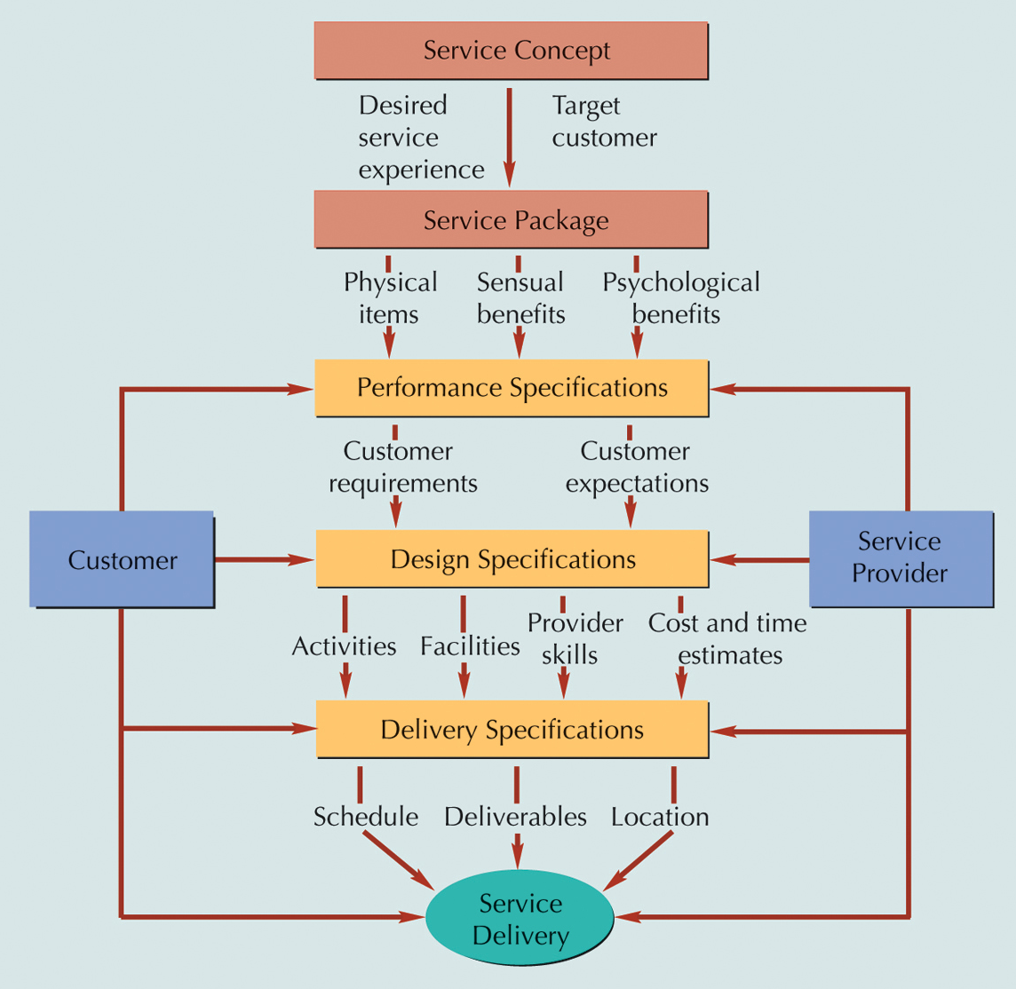
Service Design Process

Slide 10
The Well-Designed Service System
Characteristics
Consistent with the organization mission
User-friendly
Robust if variability is a factor
Easy to sustain
Cost-effective
Has value that is obvious to the customer
Has effective linkages between back- and front-of-the-house operations
Has a single, unifying theme
Has design features and checks that will ensure service that is reliable and of high quality
Copyright ©2021 McGraw-Hill Education. All rights reserved. No reproduction or distribution without the prior written consent of McGraw-Hill Education.

Slide 11
Successful Service Design
Define the service package in detail
Focus on the operation from the customer’s perspective
Consider the image that the service package will present both to customers and to prospective customers
Recognize that designers’ familiarity with the system may give them a quite different perspective than that of the customer, and take steps to overcome this
Make sure that managers are involved and will support the design once it is implemented
Define quality for both tangibles and intangibles
Make sure that recruitment, training, and reward policies are consistent with service expectations
Establish procedures to handle both predictable and unpredictable events
Establish system to monitor, maintain, and improve service
Copyright ©2021 McGraw-Hill Education. All rights reserved. No reproduction or distribution without the prior written consent of McGraw-Hill Education.

Slide 12
Operations Strategy
Effective product and service design can help the organization achieve competitive advantage:
Packaging products and ancillary services to increase sales
Using multiple-use platforms
Implementing tactics that will achieve the benefits of high volume while satisfying customer needs for variety
Continually monitoring products and services for small improvement opportunities
Reducing the time it takes to get a new or redesigned product or service to the market
Copyright ©2021 McGraw-Hill Education. All rights reserved. No reproduction or distribution without the prior written consent of McGraw-Hill Education.

Slide 13
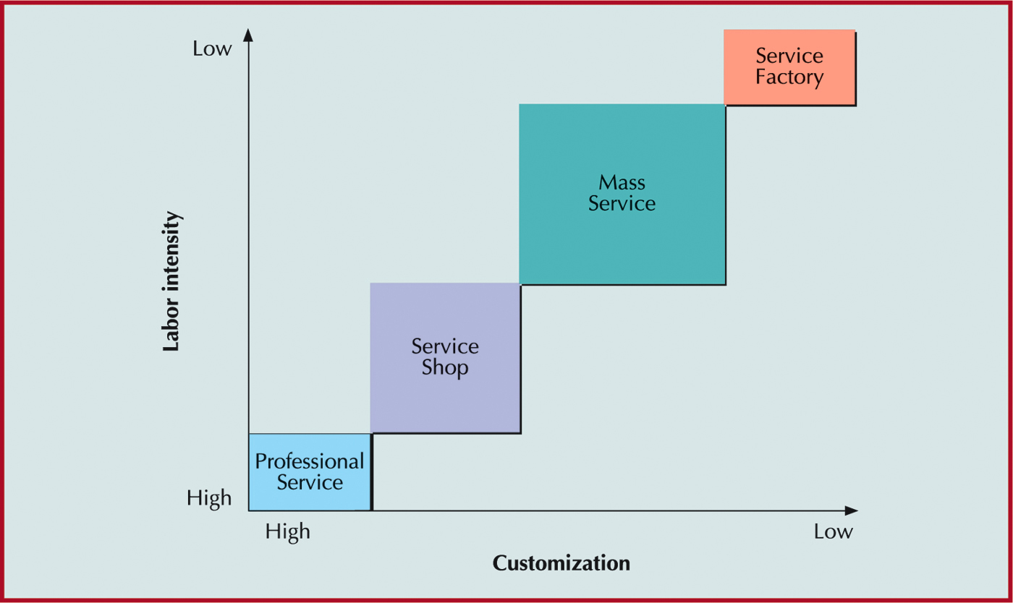
Service Process Matrix

Slide 14
High vs. Low Contact Services
Design Decision
High-Contact Service
Low-Contact Service
Facility location
Convenient to customer
Near labour or transportation source
Facility layout
Must look presentable, accommodate customer needs, and facilitate interaction with customer
Designed for efficiency

Slide 15
High vs. Low Contact Services
Design Decision
High-Contact Service
Low-Contact Service
Quality control
More variable since customer is involved in process; customer expectations and perceptions of quality may differ; customer present when defects occur
Measured against established standards; testing and rework possible to correct defects
Capacity
Excess capacity required to handle peaks in demand
Planned for average demand

Slide 16
High vs. Low Contact Services
Design Decision
High-Contact Service
Low-Contact Service
Worker skills
Must be able to interact well with customers and use judgment in decision making
Technical skills
Scheduling
Must accommodate customer schedule
Customer concerned only with completion date

Slide 17
High vs. Low Contact Services
Design Decision
High-Contact Service
Low-Contact Service
Service process
Mostly front-room activities; service may change during delivery in response to customer
Mostly back-room activities; planned and executed with minimal interference
Service package
Varies with customer; includes environment as well as actual service
Fixed, less extensive

Slide 18
Tools for Service Design
Service blueprinting
line of influence
line of interaction
line of visibility
line of support
Front-office/Back-office activities
Servicescapes
space and function
ambient conditions
signs, symbols, and artifacts
Quantitative techniques

Slide 19
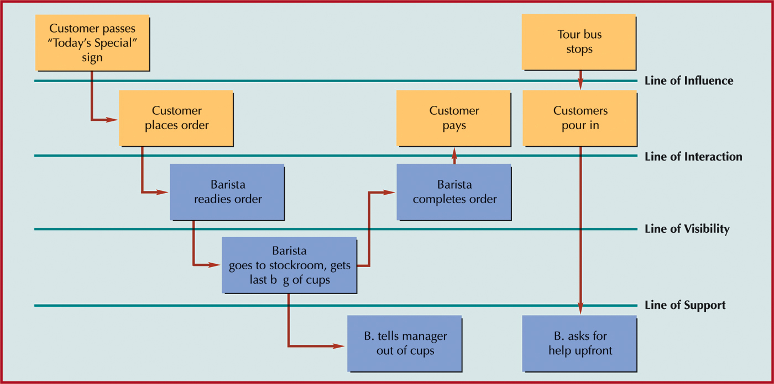
Service Blueprinting

Slide 20
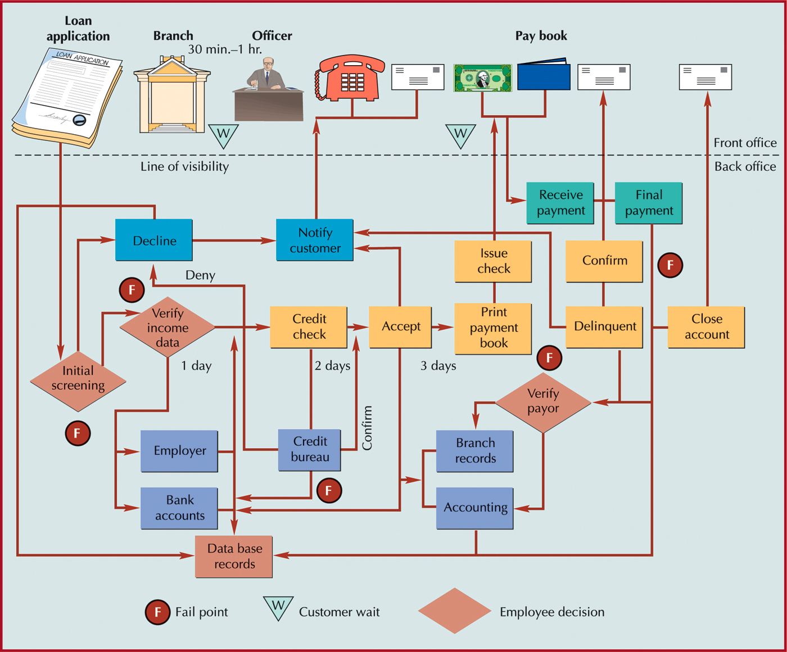
Service Blueprinting

Slide 21
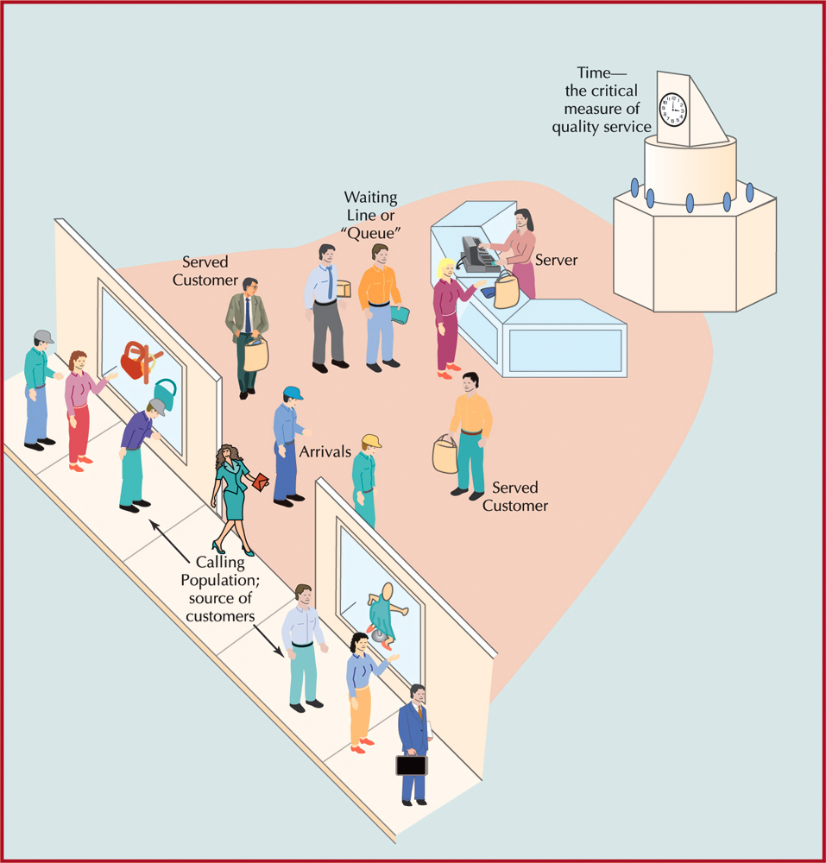
Waiting Lines

Slide 22
Elements of Waiting Line Analysis
Operating characteristics
average values for characteristics that describe performance of waiting line system
Queue
a single waiting line
Waiting line system
consists of arrivals, servers, and waiting line structure
Calling population
source of customers; infinite or finite

Slide 23
Queuing Theory
Mathematical approach to the analysis of waiting lines
Applicable to many environments
Call centers
Banks
Post offices
Restaurants
Theme parks
Telecommunications systems
Traffic management
Copyright ©2021 McGraw-Hill Education. All rights reserved. No reproduction or distribution without the prior written consent of McGraw-Hill Education.

Slide 24
Waiting Lines Understand your Customer/ Population Characteristics
Finite versus Infinite populations
Want to avoid:
Balking
Reneging
Jockeying

Slide 25
Example Priority Rules
First come, first served
Best customers first (reward loyalty)
Highest profit customers first
Quickest service requirements first
Largest service requirements first
Earliest reservation first
Emergencies first
Etc.

Slide 26
Elements of Waiting Line Analysis
Channels
number of parallel servers for servicing customers
Phases
number of servers in sequence a customer must go through

Slide 27
Waiting Line System Decide on the Number of Lines/Servers
Single servers or multiple, parallel servers providing multiple channels
Arrangement of servers (phases)
Multiple phase systems require customers to visit more than one server
Example of a multi-phase, multi-server system:
1
4
Arrivals
C
C
C
2
C
C
5
Depart
3
6
Phase 1
Phase 2

Slide 28
Elements of Waiting Line Analysis
Arrival rate (λ)
frequency at which customers arrive at a waiting line according to a probability distribution, usually Poisson
Service rate (μ)
time required to serve a customer, usually described by negative exponential distribution
Service rate must be higher than arrival rate (λ < μ)
Queue discipline
order in which customers are served
Infinite queue
can be of any length; length of a finite queue is limited

Slide 29
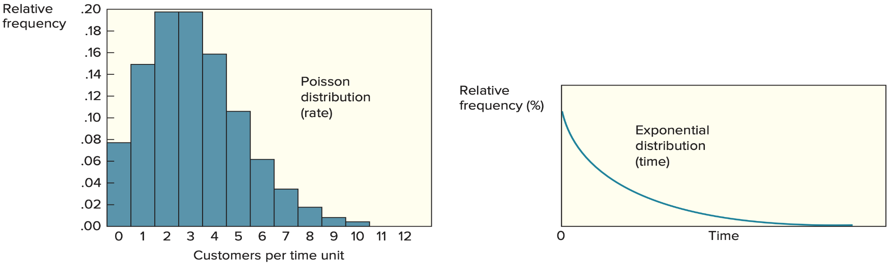
Poisson and Negative Exponential
Copyright ©2021 McGraw-Hill Education. All rights reserved. No reproduction or distribution without the prior written consent of McGraw-Hill Education.

Slide 30
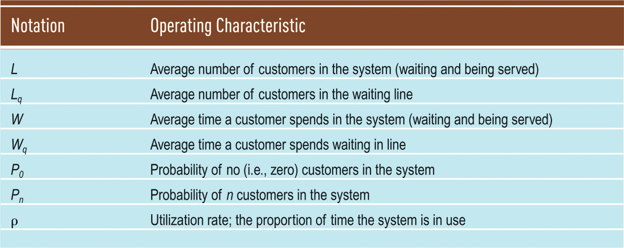
Operating Characteristics
Operating characteristics are assumed to approach a steady state

Slide 31
Waiting Line Metrics
Managers typically consider five measures when evaluating waiting line performance:
The average number of customers waiting (in line or in the system)
The average time customers wait (in line or in the system)
System utilization
The implied cost of a given level of capacity and its related waiting line
The probability that an arrival will have to wait for service
Copyright ©2021 McGraw-Hill Education. All rights reserved. No reproduction or distribution without the prior written consent of McGraw-Hill Education.

Slide 32
Basic Single-Server Model
Assumptions
Poisson arrival rate
exponential service times
first-come, first-served queue discipline
infinite queue length
infinite calling population
Computations
λ = mean arrival rate
μ = mean service rate
n = number of customers in line

Slide 33
Basic Single-Server Model (you don’t need to know how to do the calculations)
probability that no customers are in queuing system
probability of n customers in queuing system
average number of customers in queuing system
average number of customers in waiting line
( )
λ
μ
λ
μ – λ
P₀ = 1 –
L =
( ) ( )( )
λ ^{n} λ ^{n} λ
μ μ μ
λ²
μ (μ – λ)
P_{n} = ∙ P₀ = 1 –
L_{q} =

Slide 34
Basic Single-Server Model (you don’t need to know how to do the calculations)
average time customer spends in queuing system
average time customer spends waiting in line
probability that server is busy and a customer has to wait (utilization factor)
probability that server is idle and customer can be served
1 L
μ – λ λ
W = =
λ
μ
ρ =
λ
μ (μ – λ)
I = 1 – ρ
= 1 – = P₀
W_{q} =
λ
μ

Slide 35
Basic Single-Server Model Example – Disneyland Ride (you don’t need to know how to do the calculations)
λ = 24; mean arrival rate
μ = 30; mean service rate
Probability no customers
in queuing system (Po)
Average number of
customers in queuing system (L)
Average number of
customers in
waiting line (Lq)

Slide 36
Basic Single-Server Model Example – Disneyland Ride (you don’t need to know how to do the calculations)
λ = 24; mean arrival rate
μ = 30; mean service rate
(W) Average time customer spends
in queuing system.
(Wq) Average time customer spends
waiting in line.
(ρ) Probability that
server is busy and
a customer has to
wait (utilization factor).

Slide 37
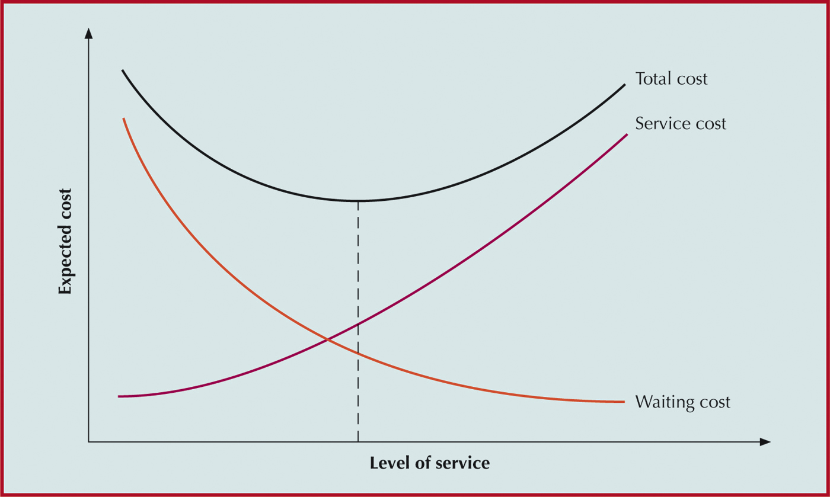
Traditional Cost Relationships
As service improves, cost increases

Slide 38
Service Improvement Analysis – Disneyland Ride
Waiting time for the ride (8 min.) is too long
Increase the service rate (How: make people move through the ride faster; effect on service experience???)
Reduce the arrival rate (How: stop people from joining the queue; effect on service experience???)
Build a second Disneyland Ride (BIG $)
Are these improvements to service worth the cost? (to us & the customer?)
How could we solve this customer service problem?

Slide 39
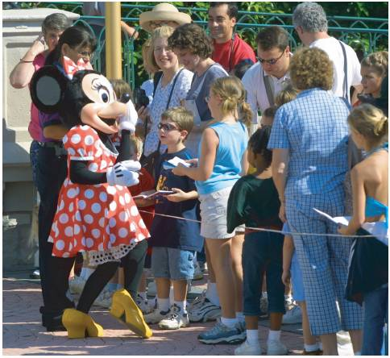
Psychology of Waiting
Other Examples:
Waiting rooms
magazines and newspapers
televisions
Bank of America
mirrors
Supermarkets
magazines
“impulse purchases”

Slide 40
Psychology of Waiting
Preferential treatment
Grocery stores: express lanes for customers with few purchases
Airlines/Car rental agencies: special cards available to frequent-users or for an additional fee
Phone retailers: route calls to more or less experienced salespeople based on customer’s sales history
Critical service providers
services of police department, fire department, etc.
waiting is unacceptable; cost is not important

Slide 41
Operations Strategy
Managers must carefully weigh the costs and benefits of service system capacity alternatives
Options for reducing wait times:
Work to increase processing rates, instead of increasing the number of servers
Use new processing equipment and/or methods
Reduce processing time variability through standardization
Shift demand
Copyright ©2021 McGraw-Hill Education. All rights reserved. No reproduction or distribution without the prior written consent of McGraw-Hill Education.

Slide 42
Basis of Front Office/Back Office (FO/BO)
Customer presence
Decoupling: separation of tasks and jobs.
To: Improve Efficiency (do more with less)
match: Worker personality type
and, Improve Quality
To address competitive advantage in terms of:
Cost Quality
Response time Delivery Speed
Flexibility Effectiveness (do the right thing)

Slide 43
Service Experience Dimensions of successful experiences
Context
Engagement
Time

Slide 44
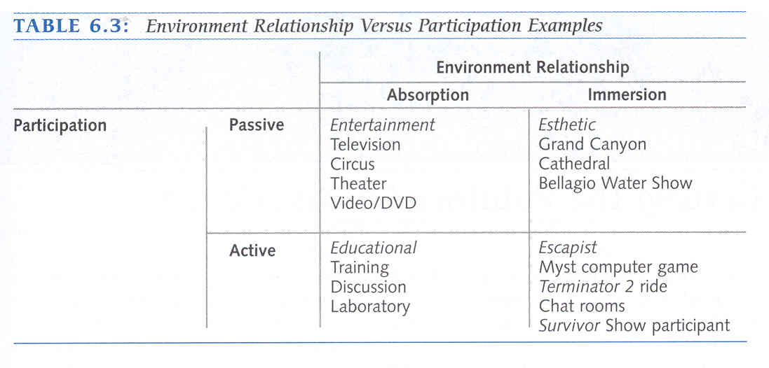
Engagement (examples)
Customer must become engaged in creating the experience either personally or virtually
Immersed or absorbed
(Source: Metters et al 2006, 101)

Slide 45
Quality of Service outcome Evaluating service experiences
Observation
Customers’ documentation
In-depth interviews
Experiential blueprinting

Slide 46
Summary: Service design, waiting lines,
service experience
Waiting lines apply to all aspects of organisational operations
Balancing cost with service is a key issue
How to ‘flow’ customers through the process
Relationship between front office/back office is crucial
The service experiences is a key aspect of managing operations in the service industry due to customers being involved in the delivery of the service.

Slide 47
In the Lecture we covered:
Service Economy
Characteristics of Services
Service Design Process
Tools for Service Design
Waiting Line Analysis for Service Improvement
Front office/Back office
Service Experience
Quality of Service outcome…

